Slide 1
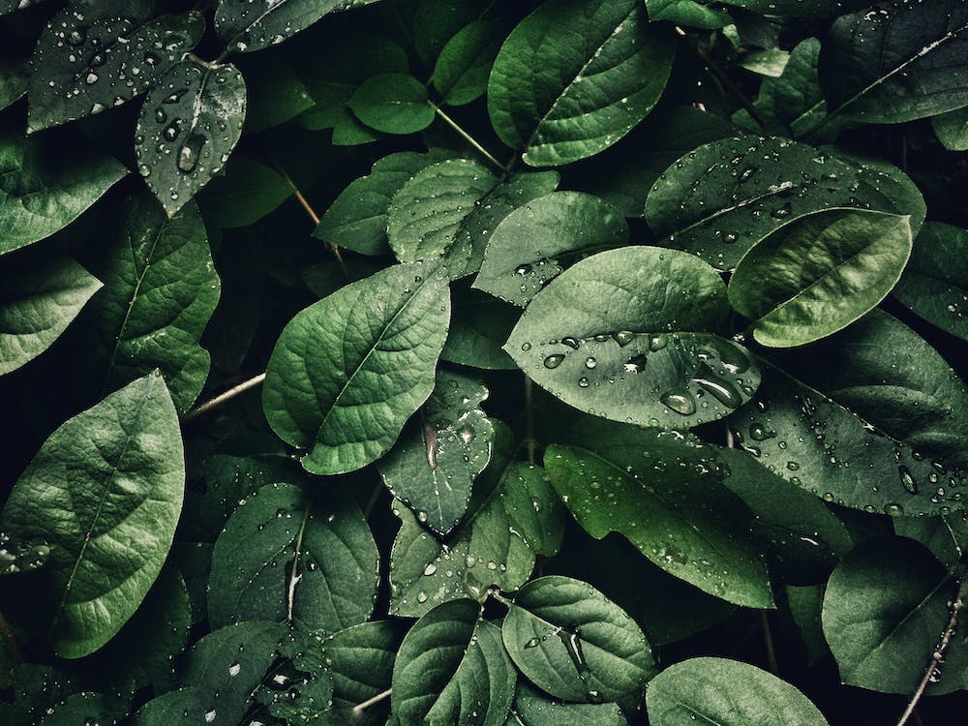

Slide 2
Classification of medicinal plants using Deep learning

Slide 3
TEAM MEMBERS
A. SATYANARAYANA
(210701235)
K.S.J.SNEHA
(210701253)

Slide 4
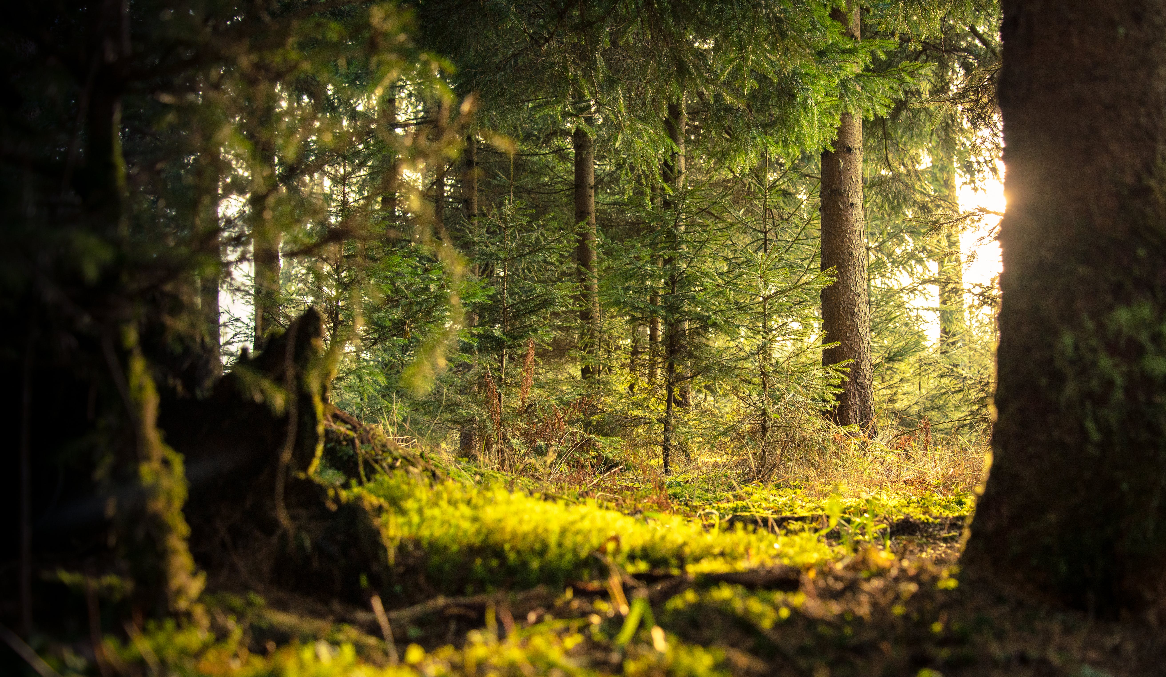
ABSTRACT

Slide 5
ABSTRACT
Project utilizes transfer learning with EfficientNetV2 architecture for plant classification.
Extensive data preprocessing: resizing, normalization, and augmentation for optimal input.
Convolutional Neural Network (CNN) trained on preprocessed image data for high accuracy.
Flask-based backend API for seamless model deployment and integration.
Users can upload images and receive precise predictions via the API.
Integration of data augmentation techniques like rotation, shearing, and flipping.
React-based frontend for user-friendly image uploading and result visualization.
Holistic approach ensures accurate plant classification and intuitive interface.
Effective and user-friendly for various plant classification and identification applications.

Slide 6
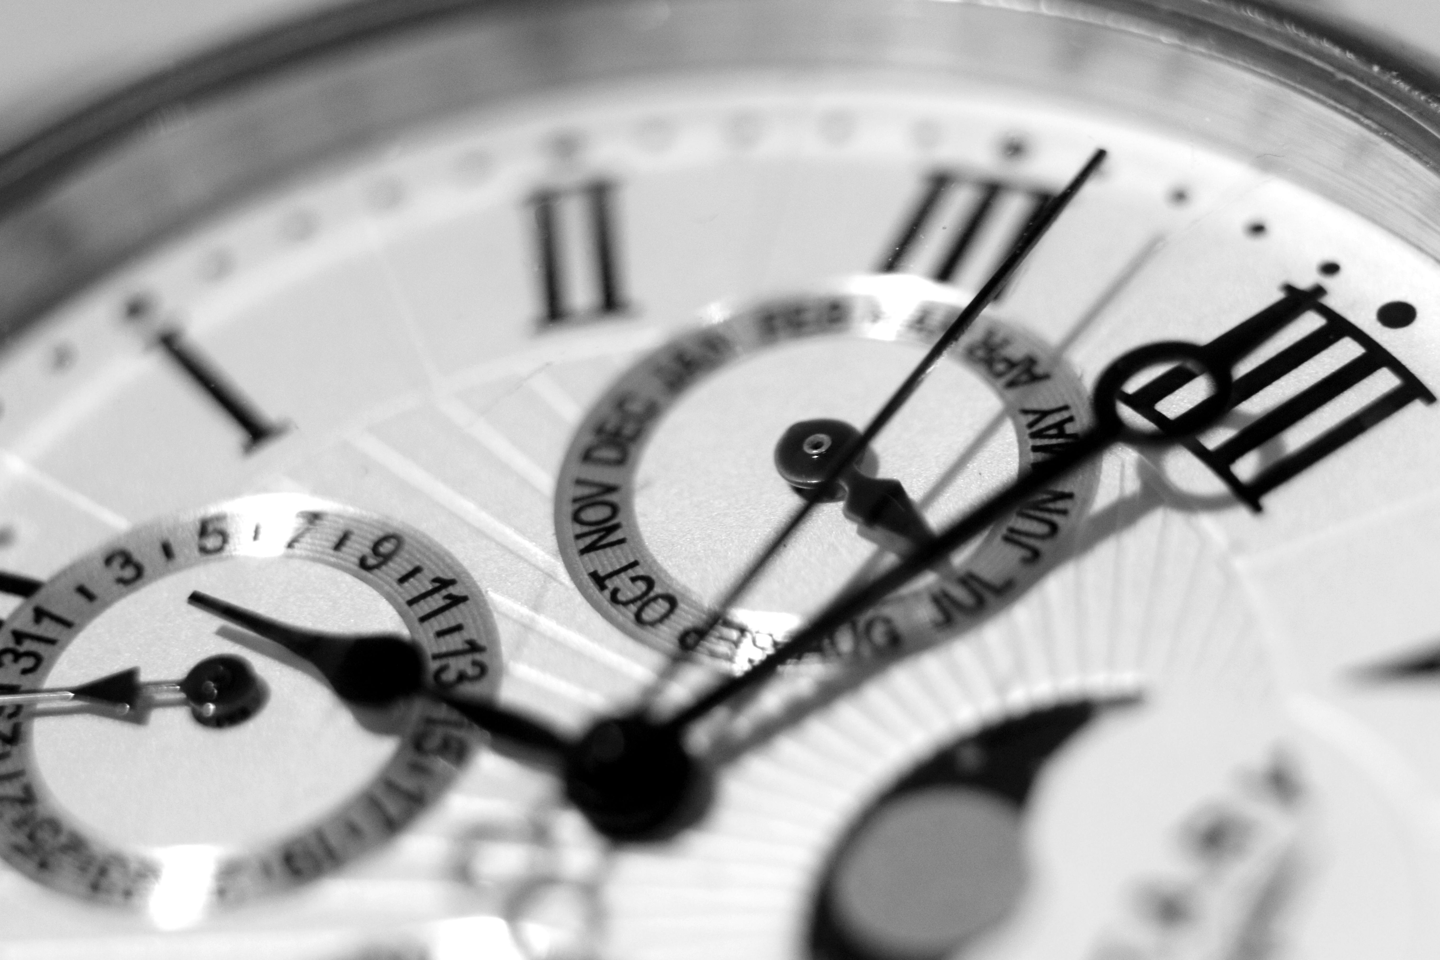



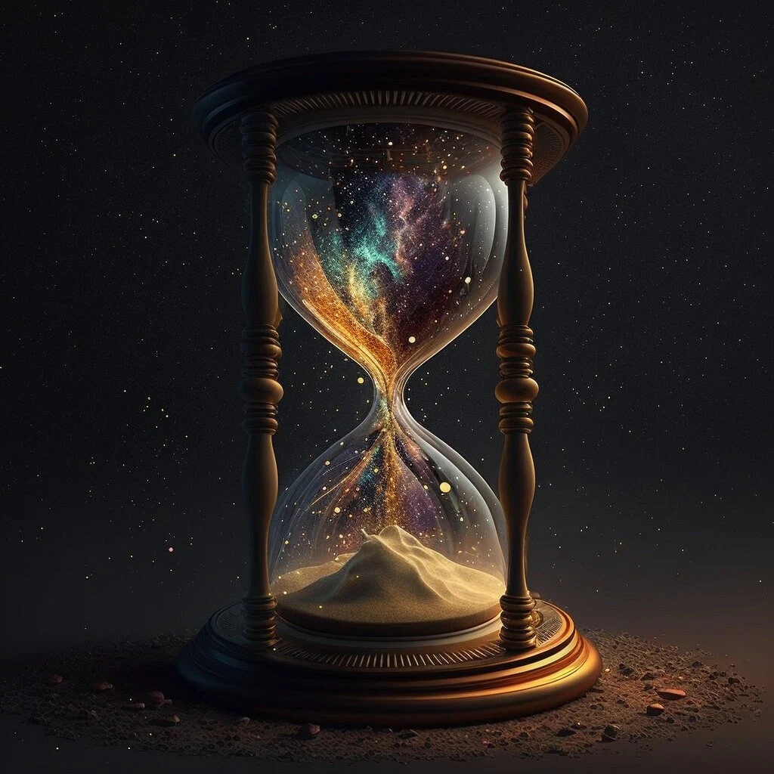
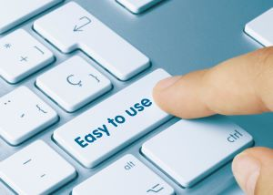

OBJECTIVES

Slide 7

ACCURATE PLANT CLASSIFICATION
OBJECTIVES
Develop a system capable of accurately classifying different plant species based on input images.

Slide 8
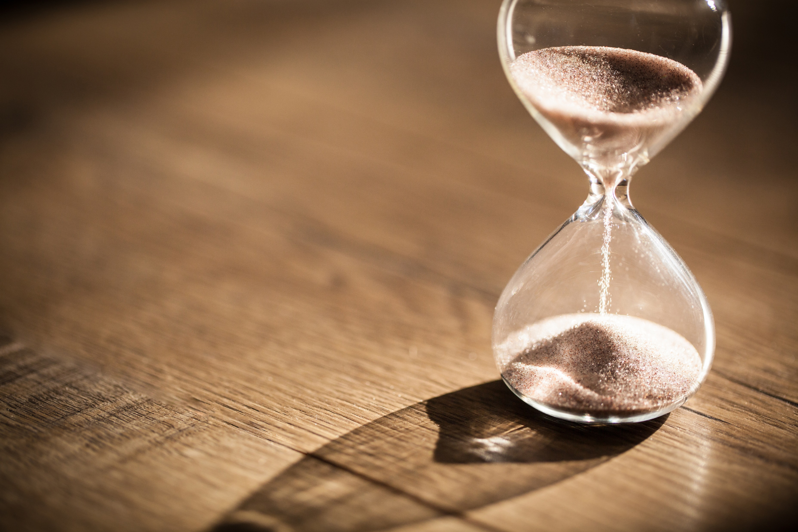
EFFICIENT MODEL TRAINING
OBJECTIVES
Implement transfer learning techniques to leverage pre-trained models for efficient and effective training on limited datasets.

Slide 9
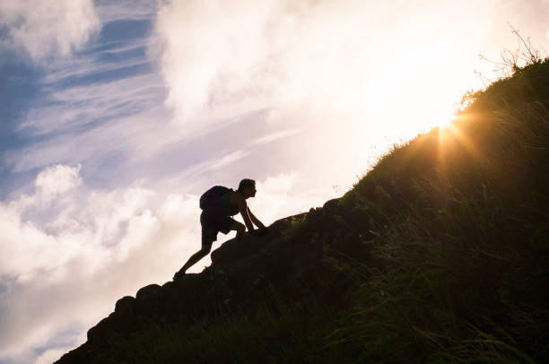
SCALABLE BACKEND
Build a scalable backend using Flask to deploy the trained model as an API, allowing seamless integration with various frontend applications.
OBJECTIVES

Slide 10

USER-FRIENDLY FRONTEND
OBJECTIVES
Develop a user-friendly frontend interface using React to facilitate easy image uploading and result visualization.

Slide 11
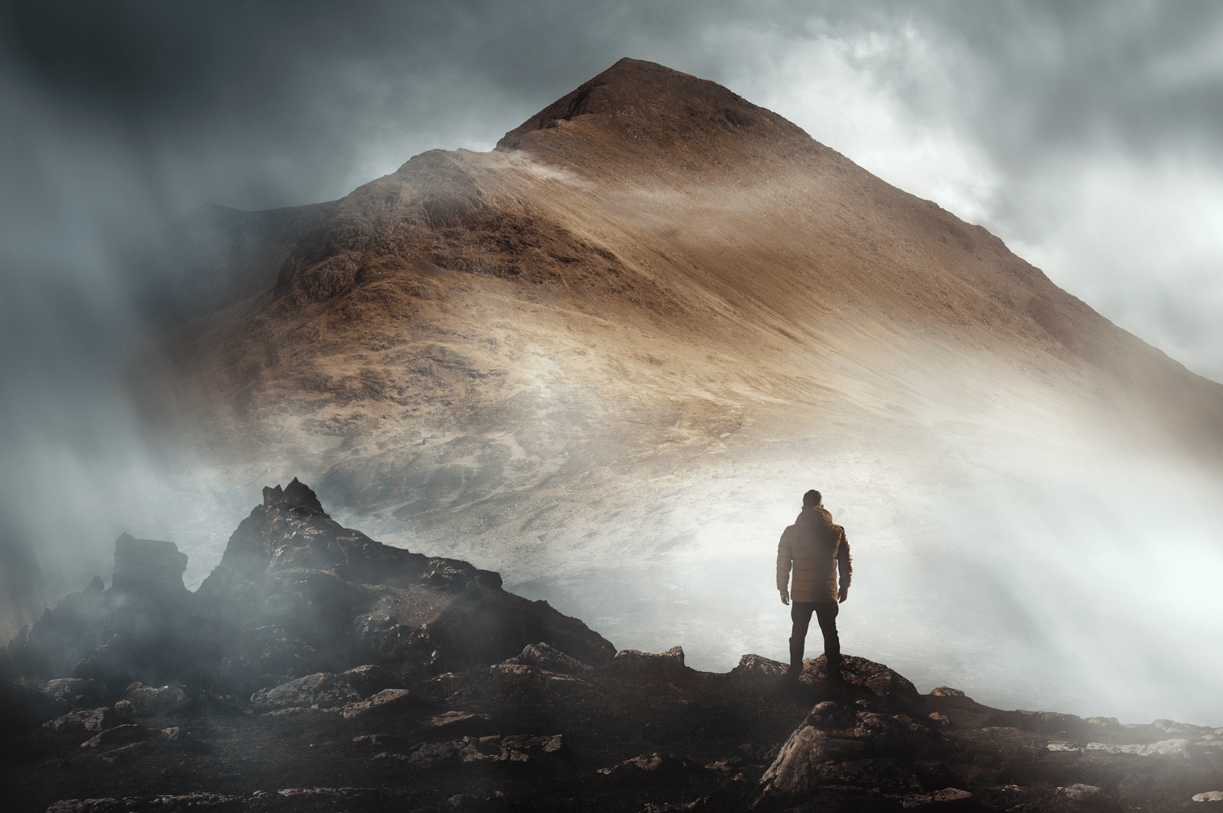
ROBUST PERFORMANCE
Ensure the system's robust performance by implementing data preprocessing and augmentation techniques to handle variations in input images effectively.
OBJECTIVES

Slide 12
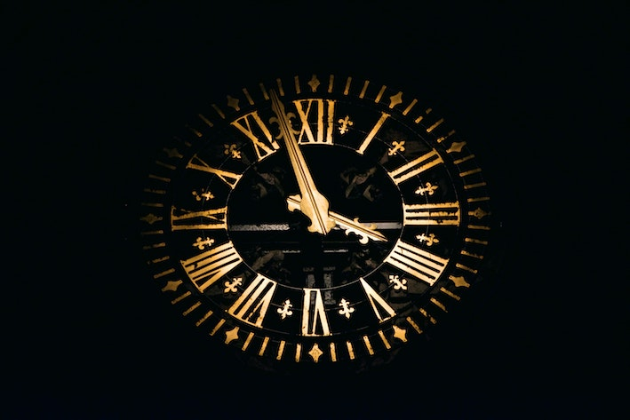
REAL-TIME PREDICTIONS
OBJECTIVES
Enable real-time predictions, allowing users to receive classification results quickly and accurately.

Slide 13

ENHANCED MODEL
GENERALISATION
OBJECTIVES
Implement data augmentation methods to improve the model's generalization ability, enabling it to classify unseen images effectively.

Slide 14
OBJECTIVES

Slide 15
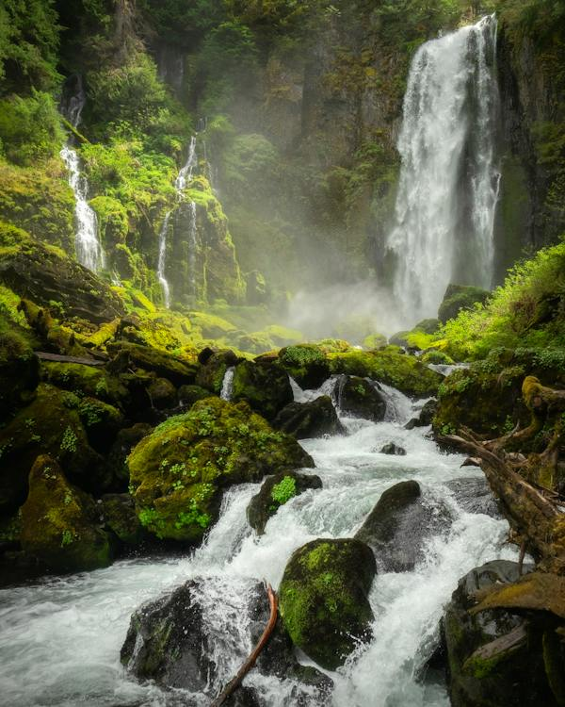
PROBLEM
STATEMENT

Slide 16
Developing a robust image classification system for identifying plant species, including medicinal plants, using machine learning techniques. The system aims to accurately classify various plant species based on images, contributing to applications in agriculture, botany, environmental conservation, and medicinal research.
PROBLEM
STATEMENT

Slide 17
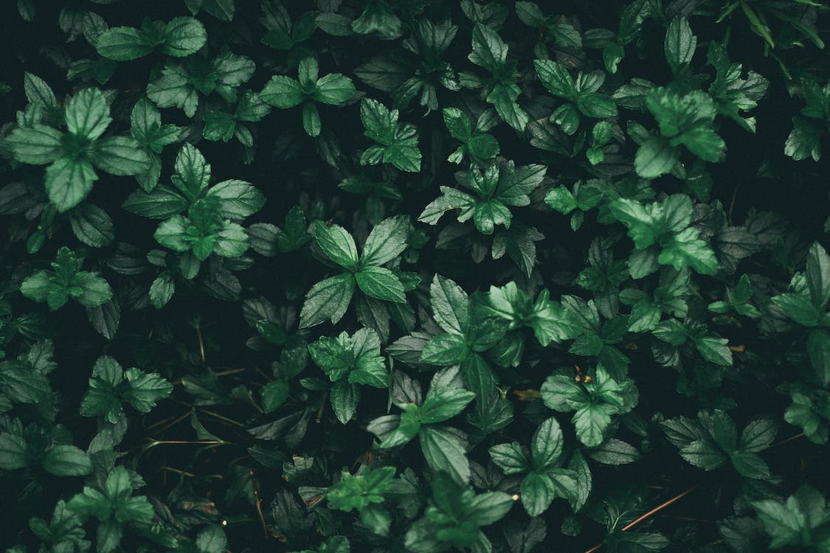
PROPOSED
EXISTING
SYSTEM
1. Manual identification
2. General-purpose tools
3. Lack of specialized expertise
4. Limited authentication capabilities
5. Reliability concerns
6. Need for specialized solutions
1.Machine learning-based identification
2. Enhanced accuracy and reliability
3. Authentication functionality
4.Customized training. 5. User-friendly interface
6. Integration with frontend

Slide 18
EXISTING
PROPOSED
SYSTEM
1. Manual identification
2. General-purpose tools
3. Lack of specialized expertise
4. Limited authentication capabilities
5. Reliability concerns
6. Need for specialized solutions
1.Machine learning-based identification
2. Enhanced accuracy and reliability
3. Authentication functionality
4.Customized training. 5. User-friendly interface
6. Integration with frontend

Slide 19
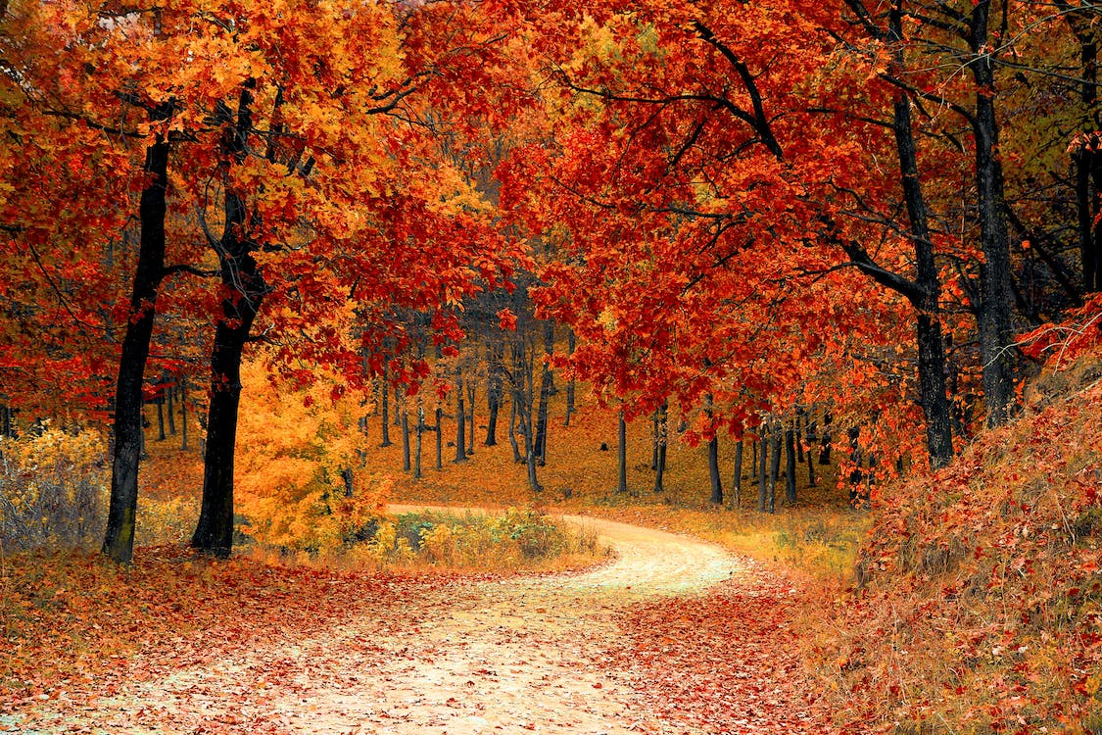
MODULES
USED

Slide 20
MODULES USED
Image Upload
Preprocessing
Model loading
API Call
Prediction

Slide 21
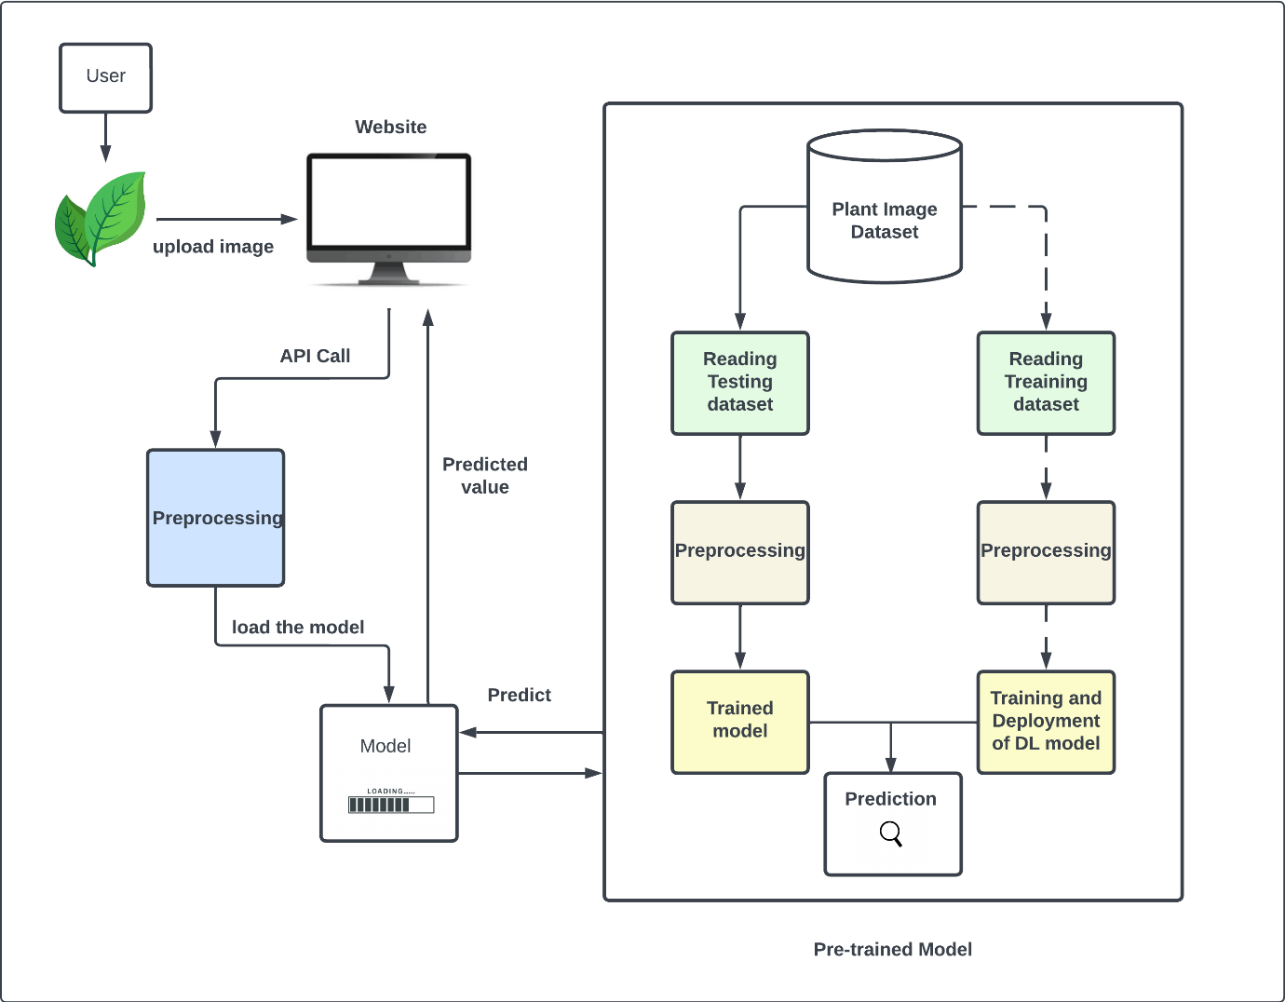
SYSTEM ARCHITECTURE

Slide 22







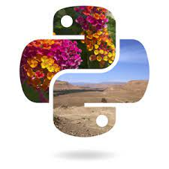
TECHNOLOGIES USED
REACTJS
React is a JavaScript library for building user interfaces. It is used to create the frontend application where users can interact with the system by uploading images of medicinal plants.

Slide 23
TECHNOLOGIES USED
FLASK
Flask is a lightweight web framework for building web applications in Python. It is used to create the backend API that handles image processing requests and serves the results back to the frontend.

Slide 24
TECHNOLOGIES USED
TENSORFLOW
TensorFlow is an open-source machine learning framework, and Keras is an API for building and training deep learning models. They are used for developing and training the machine learning model to identify medicinal plants.

Slide 25
TECHNOLOGIES USED
TENSORFLOW HUB
TensorFlow Hub is a repository of pre-trained machine learning models. It is used to access pre-trained models, such as the EfficientNetV2 architecture, for feature extraction in the machine learning model.

Slide 26
TECHNOLOGIES USED
NUMPY
NumPy is a Python library for numerical computing. It is used for numerical operations and data manipulation within the machine learning model.

Slide 27
TECHNOLOGIES USED
SCIKIT-LEARN
Scikit-learn is a Python library for machine learning. It is used for additional machine learning functionalities such as data preprocessing and model evaluation.

Slide 28
TECHNOLOGIES USED
PIL
(Python Imaging Library) PIL is a library for image processing tasks such as loading, manipulating, and saving images. It is used for preprocessing images before feeding them into the machine learning model.

Slide 29


